Slide 1
AI-Augmented Software Development Life Cycle SEZG534
Akshaya Ganesan
CSIS, WILP

Slide 2
Contact Session: 2 - Foundations and Paradigm Shift

Slide 3
Evolution of Software Development Life Cycle (SDLC) Models
Software Development Life Cycle (SDLC) is the process of planning, developing, testing, deploying, and maintenance of software systems.
The goal is to create and deploy high-quality software that meets customers’ needs and is completed within cost and time estimates.

Slide 4
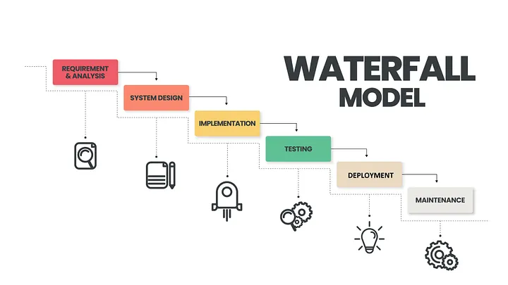
Waterfall Model
Waterfall Model (1970) provided a linear sequential approach to managing software projects.

Slide 5
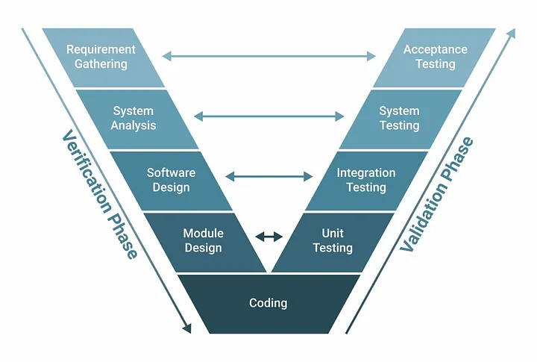
V-model
V-model (1980) was an evolution of the classic waterfall methodology.
The phases were executed in a sequential V-shape.
A testing phase was associated with each corresponding development stage.

Slide 6
Agile Model
The Agile methodology takes a flexible, iterative approach to software development.
It emphasizes collaboration, adaptability, and customer feedback, with development occurring in small, incremental cycles called "sprints.“
Iterative (1975) and Incremental (1978) models attempted to establish an agile and adaptive framework.
It involved starting with the implementation of a subset (of the software requirements) and iteratively enhancing the evolving versions until the full system was implemented.

Slide 7
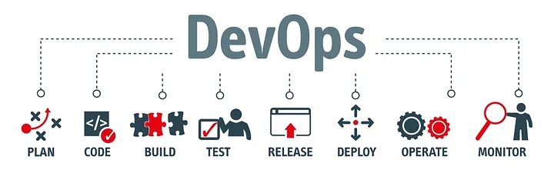
DevOps
DevOps emphasizes continuous integration and continuous deployment (CI/CD), bridging the gap between development and operations teams. I
t promotes collaboration and automation, ensuring code changes are quickly and safely deployed.

Slide 8
Comparison
Era | Core Paradigm | Iteration Cycle | Primary Bottleneck | Primary Output | AI Impact / Transformation
Waterfall (1970s–1990s) | Sequential, documentation-heavy | Months to Years | Rigid handoffs, upfront planning, and zero early feedback. | Comprehensive documentation before writing code. | AI converts unstructured spec docs straight to code & test cases.
Agile & Scrum (2000s–2010s) | Iterative, customer feedback focus | Weeks (Sprints) | Communication overhead, sprint context-switching, and manual story creation. | Working software delivered in short sprints (2–4 weeks). | AI auto-generates user stories, estimates velocity, and writes initial PRs.
DevOps & CI/CD (2010s–2020s) | Automated pipelines & continuous delivery | Days to Hours | Operational handoffs, manual testing, and deployment risks. | Continuous integration, automated deployment, and infrastructure-as-code. | AI automates pipeline failure diagnostics, auto-remediates, and predicts deployment risk.
AI-Native / Agentic SDLC (2020s+) | Autonomous AI agents, intent-driven design | Real-time / On-demand | Human verification, architectural governance, AI hallucination | Continuous, autonomous feature synthesis with human oversight (Human-in-the-Loop). | Human shifts from author/builder to orchestrator/reviewer.

Slide 9
Q and A
Is SDLC relevant?
What SDLC model is suitable for your Project?

Slide 10
Key factors driving SDLC model evolution
Accelerate software delivery, and reduce time to market
Continuously incorporate customer feedback
Reduce project risk and cost
Increase productivity, collaboration, and business alignment
Enhance software quality and security
Frequent updates to complex infrastructure without disruptions (No-downtime)
Increase automation.
Personnel/Developer/Skill shortage.
Rapid evolution of technologies: hybrid clouds, containers, Low code development platforms, 5G, IoT, AI, Big Data

Slide 11
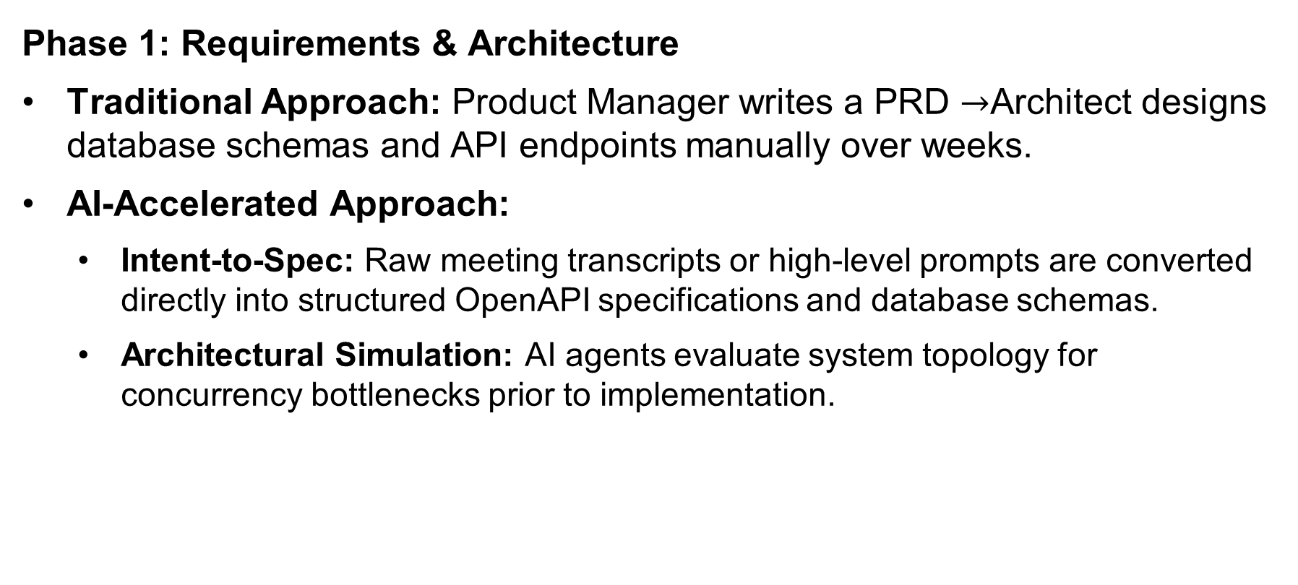

AI Impact Across SDLC Phases
Phase 1: Requirements & Architecture
Traditional Approach: Product Manager writes a PRD $→$Architect designs database schemas and API endpoints manually over weeks.
AI-Accelerated Approach:
Intent-to-Spec: Raw meeting transcripts or high-level prompts are converted directly into structured OpenAPI specifications and database schemas.
Architectural Simulation: AI agents evaluate system topology for concurrency bottlenecks prior to implementation.

Slide 12
AI Impact Across SDLC Phases
Phase 2: Software Development & Coding
Traditional Approach: Developers manually write boilerplate, look up syntax on documentation sites, and handcraft unit tests.
AI-Accelerated Approach:
Copilots to Autonomous Agents: Context-aware code completion evolved into agentic workflows capable of modifying dozens of files in parallel based on a single task prompt.

Slide 13
AI Impact Across SDLC Phases
Phase 3: Testing & Quality Assurance (QA)
Traditional Approach: Brittle testing scripts written in Selenium/Cypress requiring constant manual updates whenever UI changes.
AI-Accelerated Approach:
Self-Healing Test Suites: AI agents automatically update element locators during CI runs when UI structures change.
Autonomous Edge-Case Generation: LLMs read code branches and auto-generate test suites covering undetected edge cases.

Slide 14
AI Impact Across SDLC Phases
Phase 4: Code Review & Governance
Traditional Approach: Peer code reviews taking 24–72 hours, often missing subtle security flaws or edge cases due to fatigue.
AI-Accelerated Approach:
Static & Semantic AI Reviewers: Real-time semantic analysis flags security vulnerabilities (OWASP Top 10), performance regressions, and architectural pattern violations before human notification.

Slide 15
AI Impact Across SDLC Phases
Phase 5: Operations & Incident Response (AIOps)
Traditional Approach: Engineers wake up at 2:00 AM, search through splunk logs, and manually trace back stack traces.
AI-Accelerated Approach:
Autonomous Remediation: AI agents analyze runtime logs, correlate them with recent pull requests, auto-generate a fix or rollback, and present a root-cause summary to the SRE on call.

Slide 16
References
https://www.atlassian.com/agile/software-development/sdlc

Slide 17
Thank you

